Slide 1

ENCRYPTION AND DECRYPTION USING MAYAN’S SCRIPT
Adil.M.Khokhawala 18BCY10007
Aakash. Vats 18BCY10002
Devyani.Senwar 18BCY10031
Tanishka.Rastogi 18BCY10106

Slide 2
INTRODUCTION TO MAYAN’S SCRIPT
Mayan numeration system was used in the MAYA civilization of the Mesoamerican period.
The earliest inscriptions found which are identifiably Maya date to the 3rd century BCE in San Bartolo, Gautemala.
The Mayas used a positional base-twenty (vigesimal) numerical system which only included whole numbers. For simple counting operations, a bar and dot notation was used.

Slide 3
Existing Work
At present, we have created a basic encryption program, with a simple key.
We are building and working on the key which enables the encryption and decryption system of the program using mayan script.
At present there are various encrypting and decrypting systems with simple keys, but our project uses the ancient script of MAYAN.

Slide 4
PROPOSED WORK
In our project we will demonstrate both encryption and decryption of numbers using mayan numeration method.
Instead of dots and line representation we will represent the data in the form of 0’s and 1’s.
Our program will be a full proof secured system for encrypting data or decrypting it.
It will be very difficult for a person to crack the data which undergoes our program as the message will be pure binary.

Slide 5

MAYAN NUMERAL SYSTEM REPRESENTATION

Slide 6
PROBABLE APPLICATION AREAS
Our encryption and decryption system can be used by various security systems which enable encryption of text as not everyone knows the idea of MAYAN script.
Notably, if they are not familiar with mayan script , it would be impossible to get a message from a bunch of 0’s and 1’s unless the attacker knows the key concept we have used.
It can be used for communicating messages securely without any possibility of loss of data.

Slide 7
TECHNOLOGY & HARDWARE REQUIREMENTS
We are using the C++ , python programming language to build the encrypting and decrypting system.
Laptop with 2gb or above RAM.
Latex editor
Dev C++
PyCharm

Slide 8
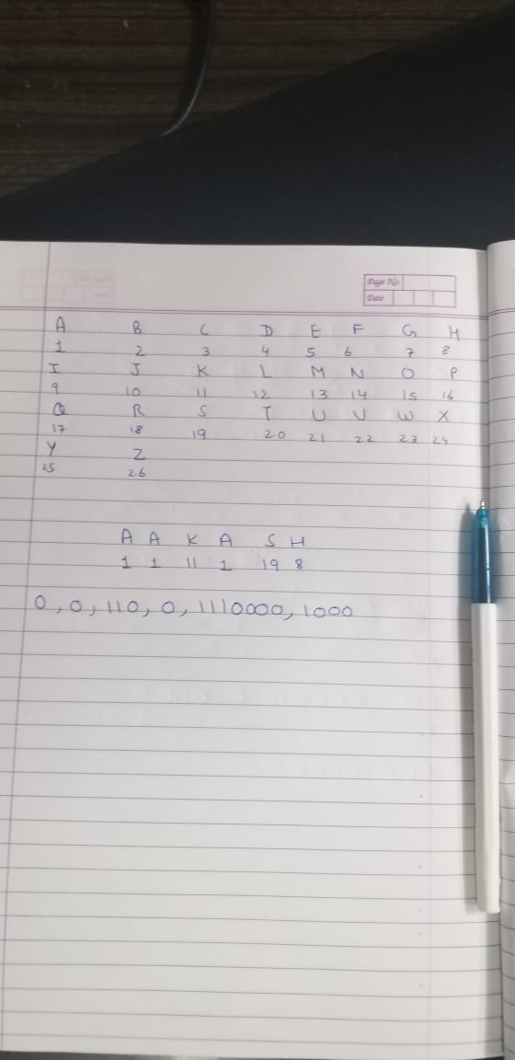
Status of coding (LOGIC)

Slide 9
EXPLANATION
The image explains that we have taken the representation of mayan numeral system , ie. Dots and lines in the form of 0’s and 1’s.
Notably, every letter of the alphabet has a value for eg. A=1 , B=2 etc.
Hence we take the value of each letter and produce the output in the form of 0’s and 1’s instead of dots and lines.

Slide 10
VARIOUS ERRORS AFTER DISCUSSION
After a discussion with our project guide , we discovered some errors in our code.
Firstly the output of our code is very big in size.
Secondly, we need to perform CRC (cyclic redundancy check) as there are loss of bits during execution of the program.

Slide 11
CRC(CYCLIC REDUNANCY CHECK)
A cyclic redundancy check (CRC) is an error-detecting code commonly used in digital networks and storage devices to detect accidental changes to raw data.
CRCs are so called because the check (data verification) value is a redundancy (it expands the message without adding information) and the algorithm is based on cyclic codes. CRCs are popular because they are simple to implement in binary hardware, easy to analyze mathematically, and particularly good at detecting common errors caused by noise in transmission channels.

Slide 12
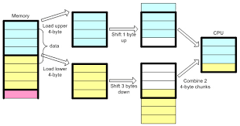
PADDING CONCEPT

Slide 13
PROPOSED SOLUTION
From the errors in our project we have come with the solution of the size of output by introducing the concept of padding which aligns the characters in order.
We will do a CRC check which will help us prevent loss of bits and data.

Slide 14
PROJECT TIMELINE
Last week of August – Idea proposed and discussed with our guide.
1st week of September- Work started
2nd week of October – Basic program with entitled key.
4th week of October- Complete program.
^{1st} week of November- Full work completed with final touches as guided by our project guide.

Slide 15

THANK YOU

